Slide 1


Feb 8, 2011
Franchise Business Intelligence
UNIT ECONOMICS
The Franchisee’s Road to Profitability

Slide 2

Why Business Intelligence?
You can’t Manage…
…what you don’t Measure!

Slide 3
The Benefits of Business Intelligence
Better Decisions
Maximize Revenue, Minimize Costs, Drive Profits
More Wisdom
Heightened insight into Your business
Increase system acumen, release untapped potential
Better Understanding
Improved Knowledge
More Information
Automation saves Time, Energy and Money
Accurate data on a timely basis
High-Level reports and dashboards
Easier Analysis vs. arcane/outdated reports
Full Data Visibility: Current & Historical
Benchmarks for targeted measurements
Key Indicators and Alerts to target areas for improvement
Identify & Drive Best Practices to assist underperforming Zees
Evaluate effectiveness of strategic initiatives
Comparative metrics: Peer Group & Regional Comparisons
Consolidation of franchisee financial & operational data
Prepare your franchise business consultants
Identify & Drive Best Practices to assist underperforming Zees
Key Indicators and Alerts to target areas for improvement
Benchmarks for targeted measurements
Comparative metrics: Peer Group & Regional Comparisons
Automation saves Time, Energy and Money

Slide 4
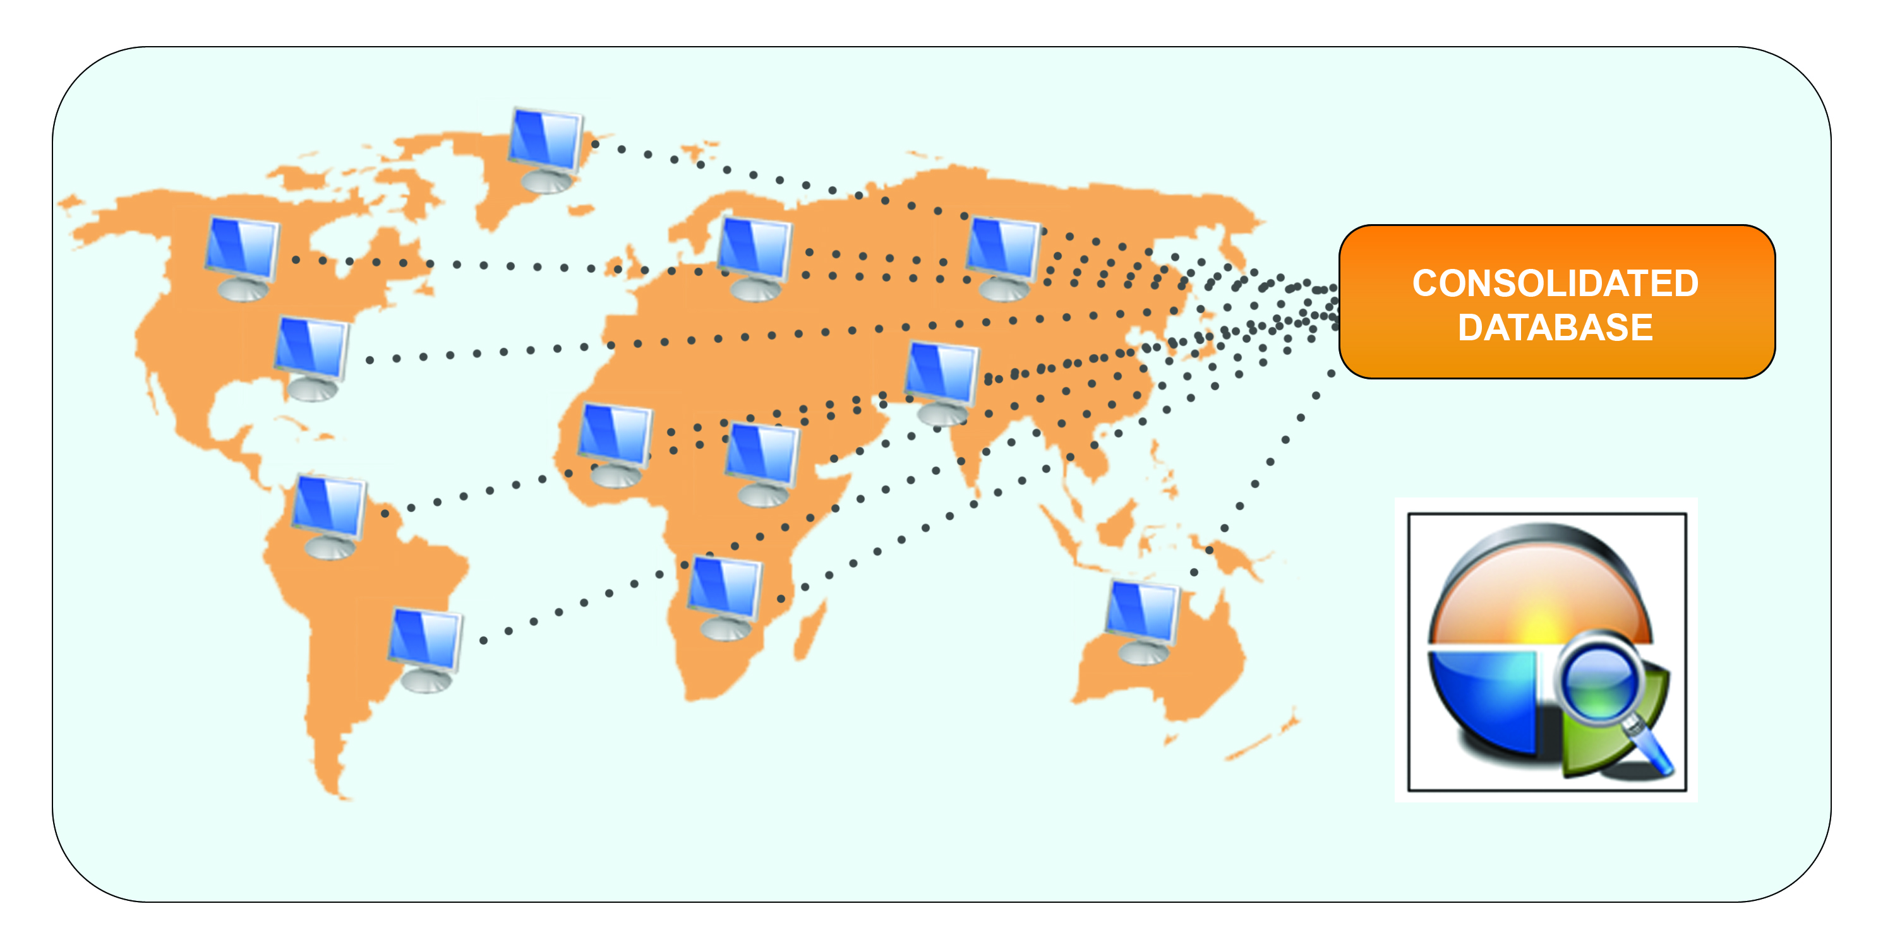




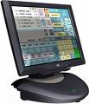



Data Collection and Consolidation
Raw Data
+
Web Form
+
Spreadsheets
+
Accounting
+
POS
+
LOB
=
Business Intelligence

Slide 5
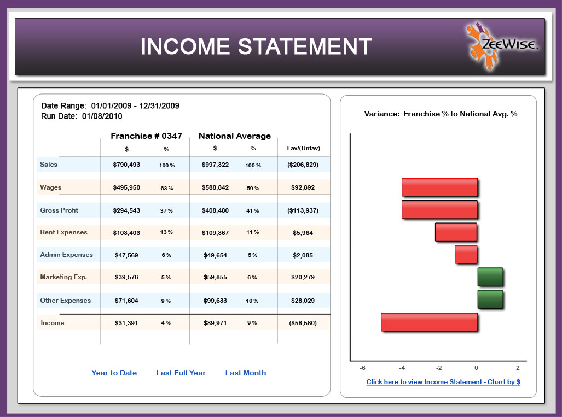

Slide 6
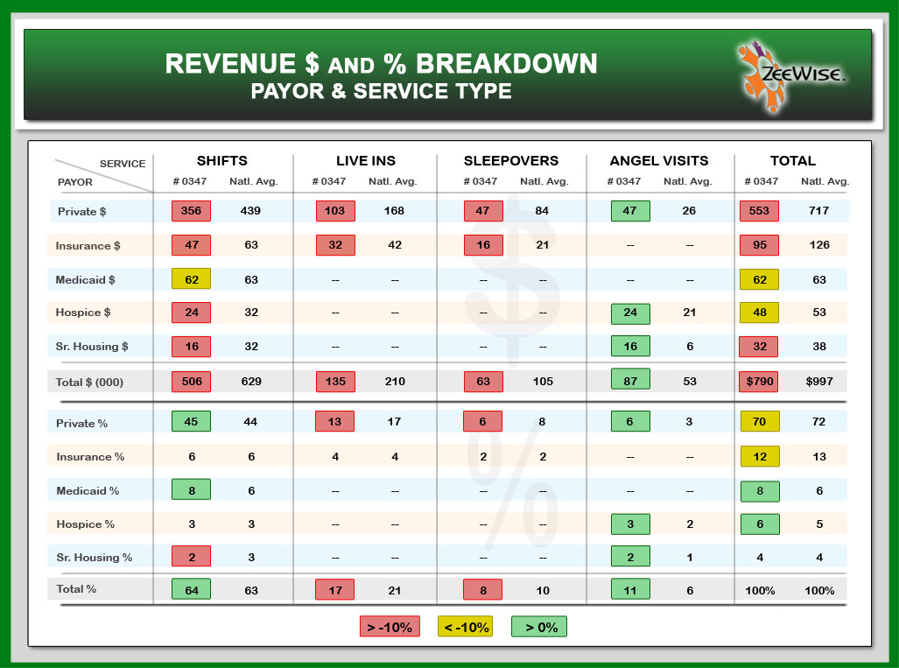

Slide 7
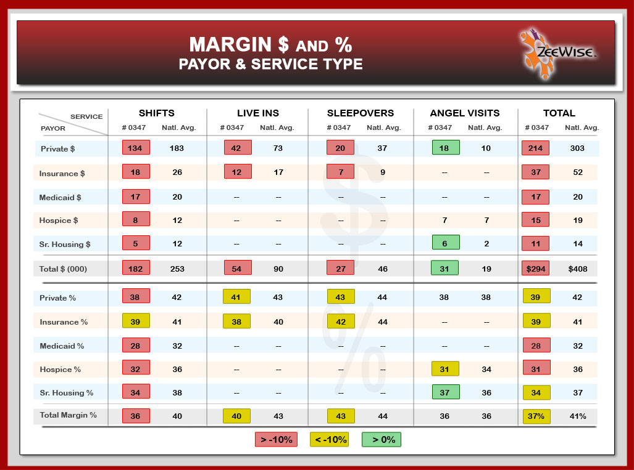

Slide 8

Why?
…BECAUSE YOU DON’T WANT TO END UP LIKE THIS CROWD!!

