Slide 1

Unit Economics –
The Franchisee’s Road to Profitability
Presented to:
Southeast Franchise Forum
February 8, 2011
Presented by:
Barry J. Falcon

Slide 2



Slide 3



What’s Important?

Slide 4

Top Priority:
ZEE
PROFITABILITY
30-30-11

Slide 5
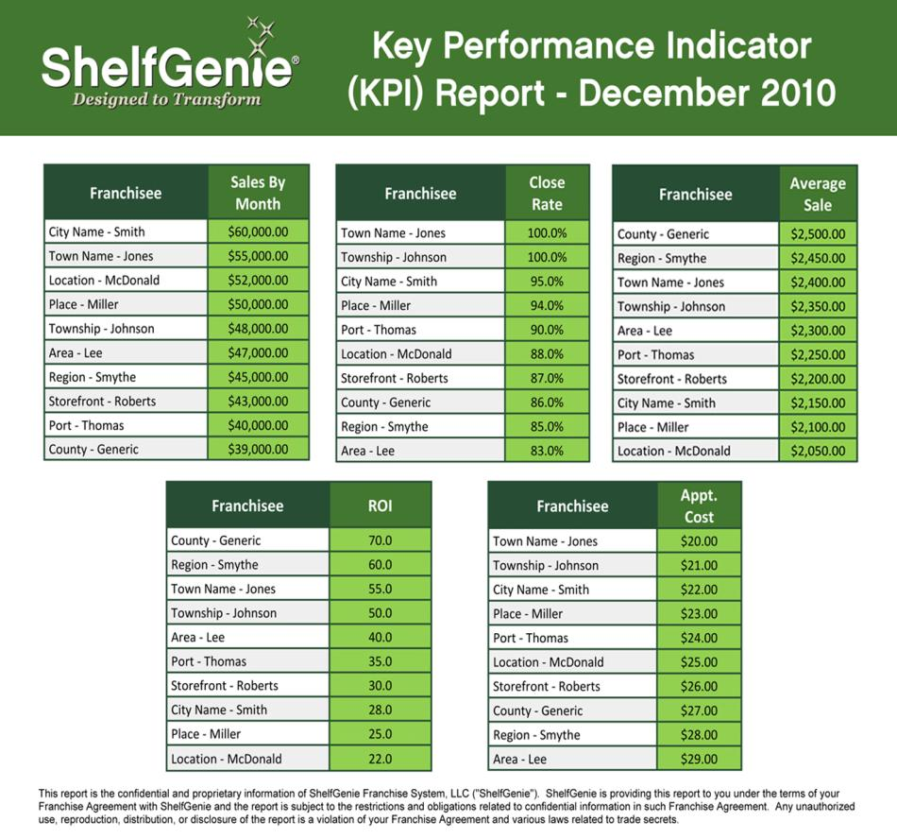

3 Critical KPI’s for Profitability
Cost Per Lead
Close Rate in the Home
Average Order

Slide 6
ShelfGenie Culture
Teamwork
Task Forces
Regional Meetings
Regional Calls
Leadership Calls
Leadership Summit
Sharing Best Practices
Group Volume Incentives
National Media Buying

Slide 7

