Slide 1
Building and Selling a Franchise Brand: The Cartridge World Story
Burt Yarkin, Managing Director
The McLean Group, LLC
January 26, 2011

Slide 2
Cartridge World
Brand had initial success in Australia and the UK
Launched in the U.S. in January 2003
First year focused on initial store openings and Master Franchising the U.S.
Focused on adjustments to the operating model and franchise support

Slide 3
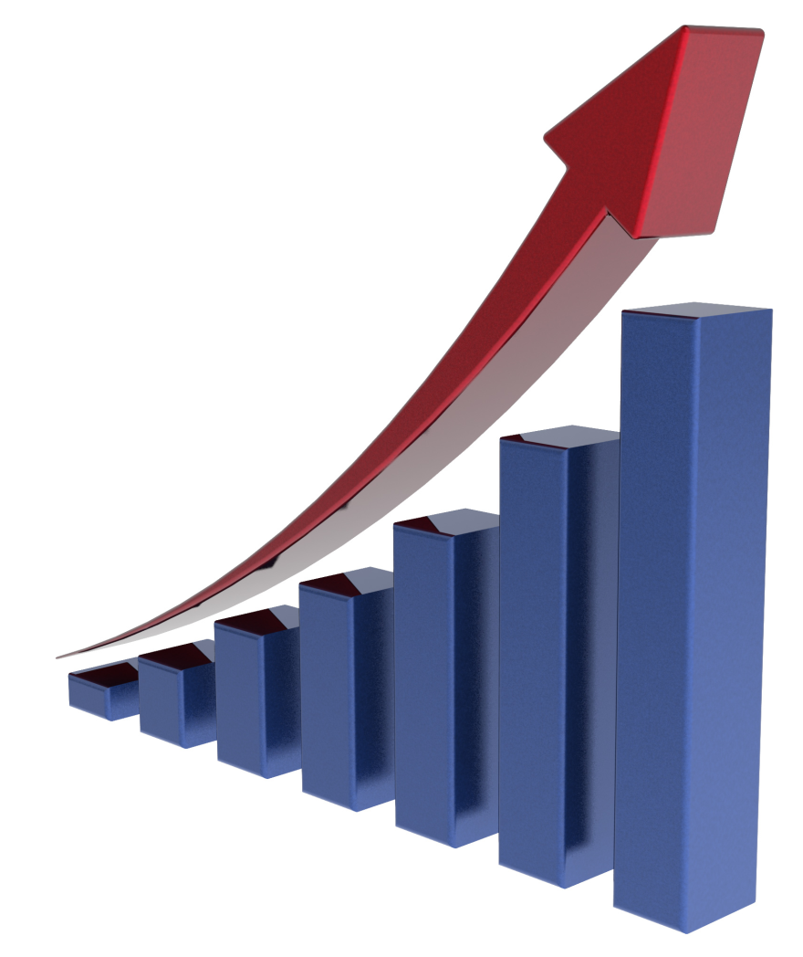
Cartridge World
Initial success in the U.S.
Great PR and strong interest in the brand
Started opening 100-200 units per year in the U.S.
Rapid international growth through Master Franchising

Slide 4
Cartridge World
Significant investments in infrastructure to support our growth
Focus on quality control
Investments in IT, training centers, and financial controls
Senior staff
Moved global headquarters to California from Australia
4

Slide 5
Cartridge World – The Exit Plan
Engaged investment bankers early
Hired CFO early in the process
Continued focus on growth and hitting our numbers
Upon sale had 600 units open in the U.S. and 1,600 globally in 50 countries
Private auction
Completed transaction August 2007

